Slide 1
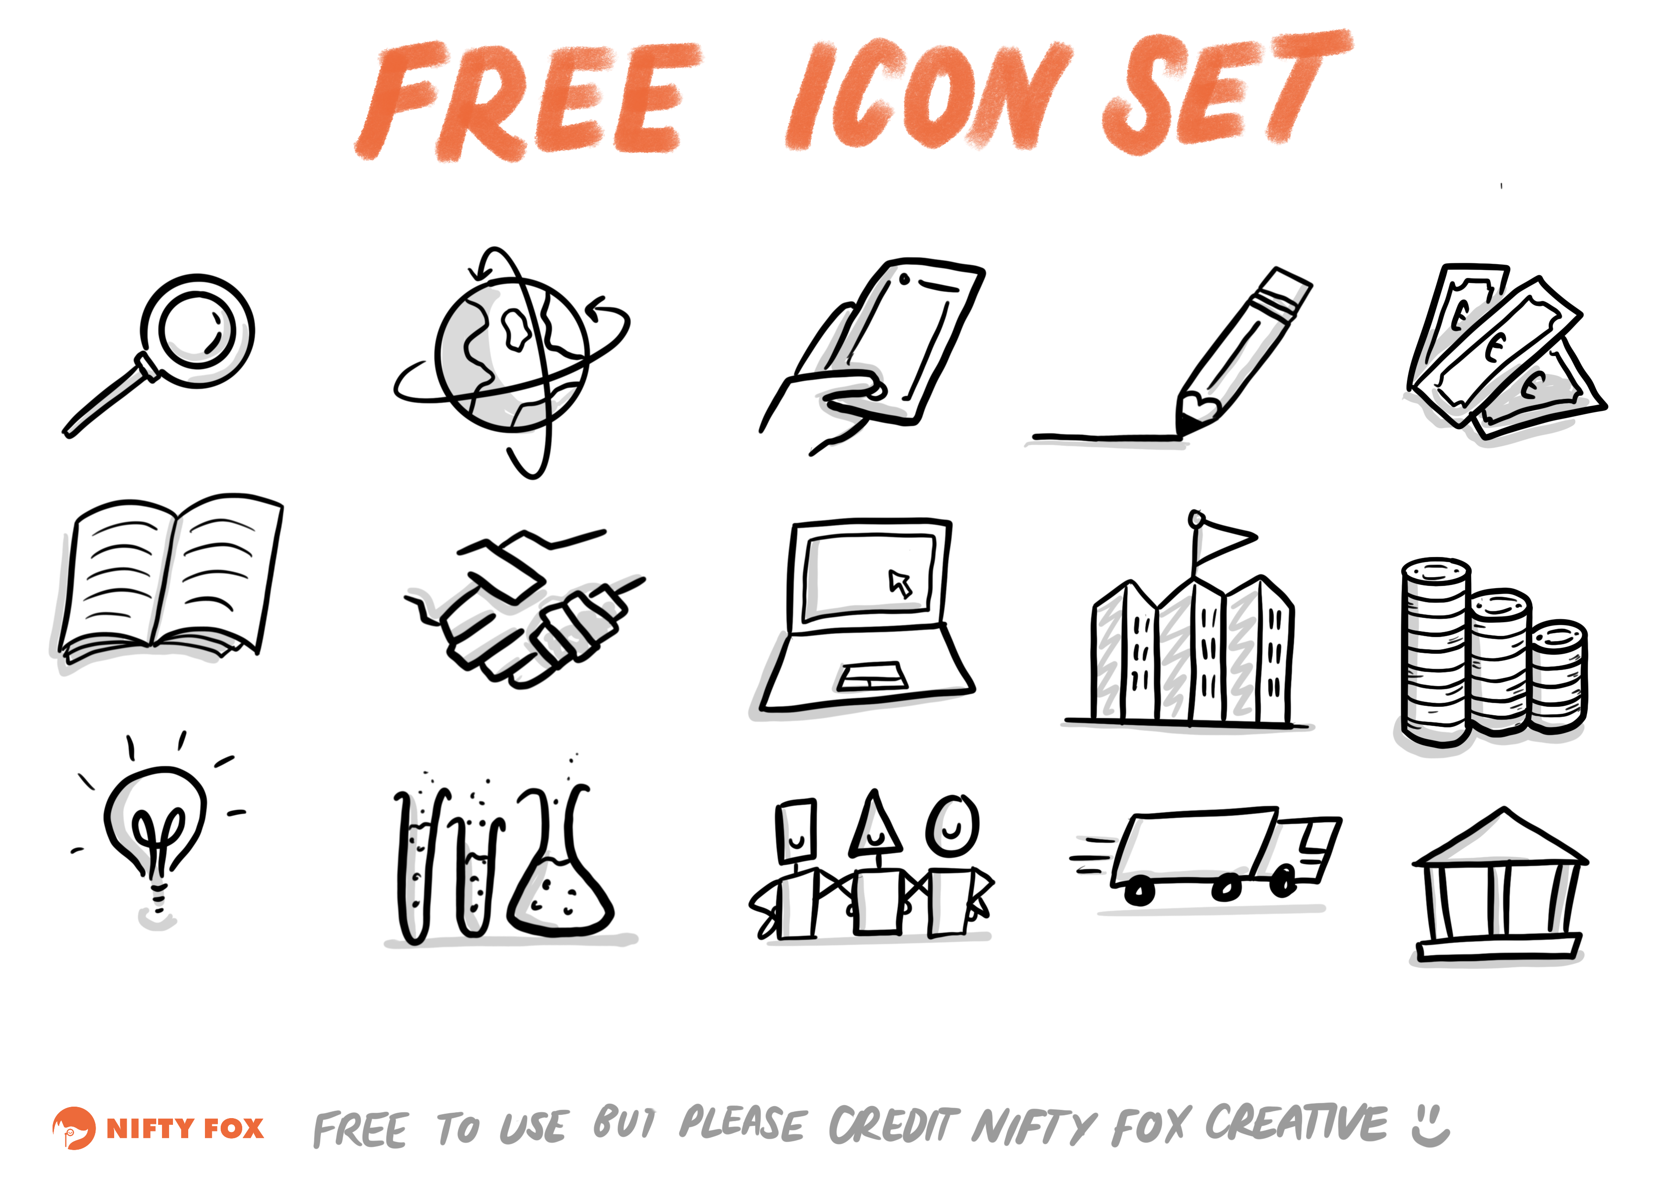
Crop the image to the icon you would like to use and then resize ☺!

